Slide 1







TECHNOLOGY TRENDS & ANALYSIS
Findings & Implications
Ikiriko Sowunari Joseph
27th APRIL, 2023

Slide 2



OUTLINE
Executive Summary
Introduction
Methodology
Results
Visualization – Charts
Dashboard
Discussion
Findings & Implications
Conclusion
Appendix

Slide 3

EXECUTIVE SUMMARY
Current Technology Usage
Top 10 Languages and Databases Worked With
Mostly Used Platforms
Top 10 Web frames
Future Technology Trends
Top 10 languages and Databases
Platforms
Top 10 Web frames
Demographic Survey
Technological gaps in countries
Gender gaps in jobs

Slide 4

INTRODUCTION
Aim:
To understand the Technological trends
Identify skills requirements for the future
Identify the top Languages in demand
Identify the top Databases in demand
Identify the Popular IDEs

Slide 5

METHODOLOGY
Data Collection
Data Exploration
Data Cleaning
Data Visualization
Presentation of Data

Slide 6
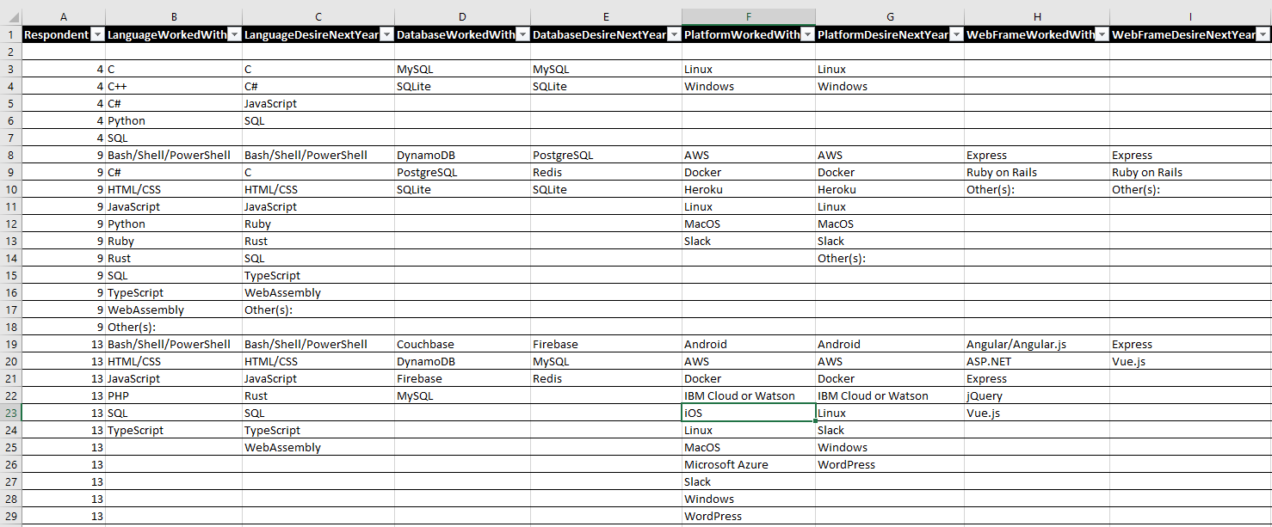
RESULTS

Slide 7
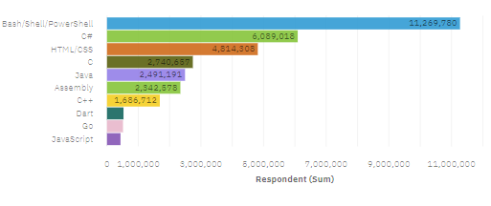
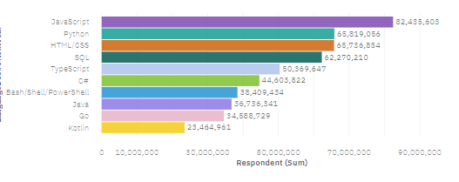
PROGRAMMING LANGUAGE TRENDS
Top 10 Languages Worked With
Top 10 Languages Desired Next Year

Slide 8
PROGRAMMING LANGUAGE TRENDS - FINDINGS & IMPLICATIONS
Findings
Bash/Shell/PowerShell which is in high demand in the current trend, have low demand in the future trend
HTML/CSS are still in demand both in the current trend and future trend
JavaScript and Python has the rising trend
Implications
The relevance of Bash/Shell/PowerShell are becoming low due to the development of AI and ML
Web development are still in high demand
Python and JavaScript are essential skills to be place more focus on

Slide 9
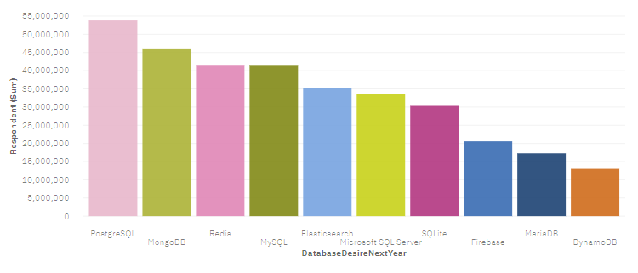
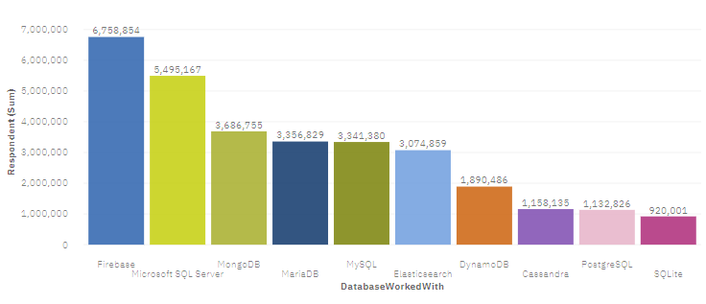
DATABASE TRENDS
Next Year
Current Year

Slide 10
DATABASE TRENDS - FINDINGS & IMPLICATIONS
Findings
RDMS has the dominant trend in the current usage.
Non – RDMS have the dominant trend in future.
Implications
People are highly interested in learning non - relational databases.
Big Data have a rising popularity and should be placed more focus.

Slide 11

DASHBOARD
https://eu-de.dataplatform.cloud.ibm.com/dashboards/6880fcef-a2da-4bfe-aa11-c4e76f5a1968/view/4120a3601ea362fe64eac4e4079d7d0f2c332459e7bbd202858d7b495b357597a9601495c8291e08db470c31f4b8410d9a

Slide 12
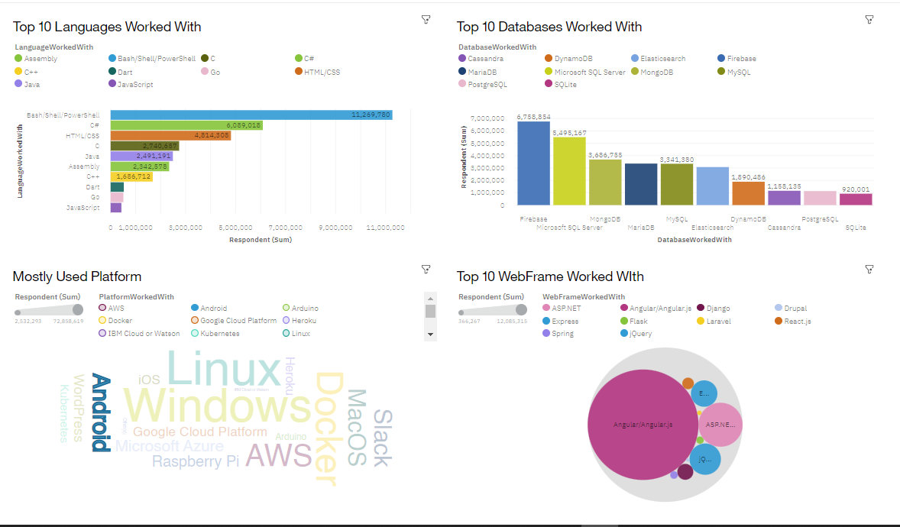
DASHBOARD TAB 1

Slide 13
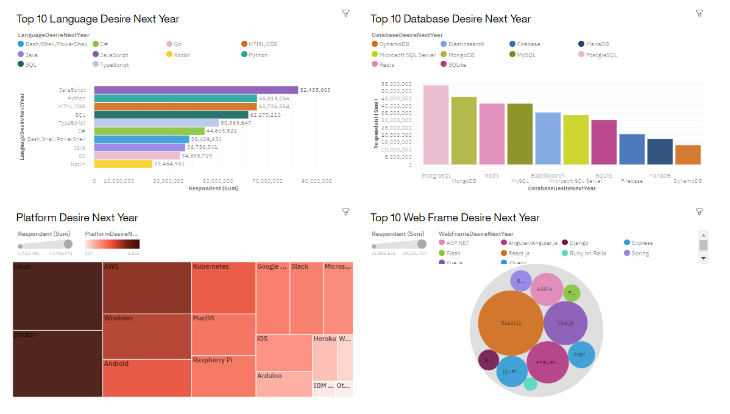
DASHBOARD TAB 2

Slide 14
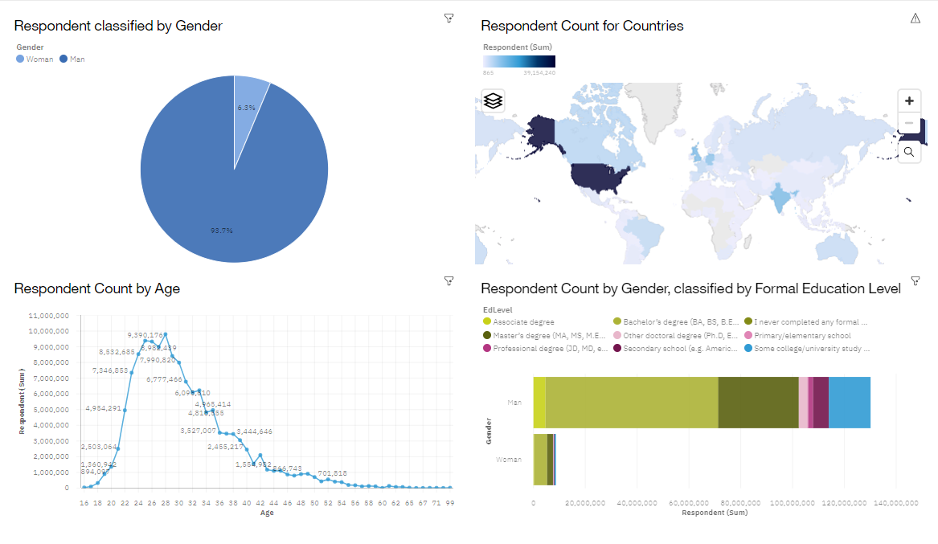
DASHBOARD TAB 3

Slide 15
DISCUSSION
Training and Reskilling Workers
Placing focus on Big Data and advance programming languages
Technological gap in different countries
Eliminate age and education discrimination in employment

Slide 16
OVERALL FINDINGS & IMPLICATIONS
Findings
The Technological trends are fast changing
Gender gap in technological jobs
Platform like Docker and AWS are on the rise
Implications
Companies should be flexible and adjust those changes in their activities
Impact job hiring
Shifts to faster app developments and clouds services

Slide 17

CONCLUSION
Technological trend for both current year and next year
Trending Demands in skill
Demographic overview
Actions to be taken

Slide 18
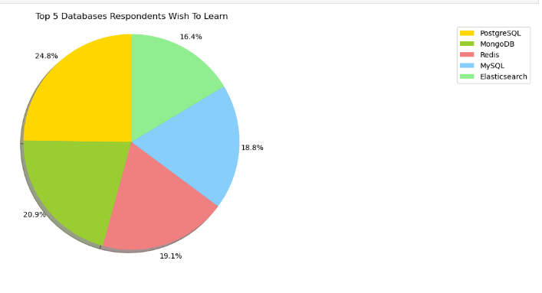

APPENDIX

Slide 19
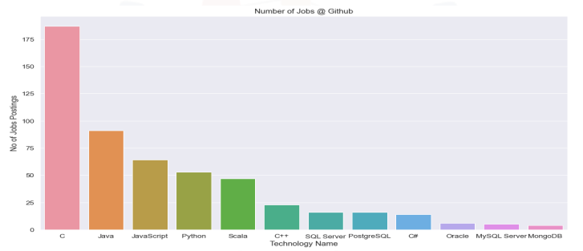
JOB POSTINGS

Slide 20
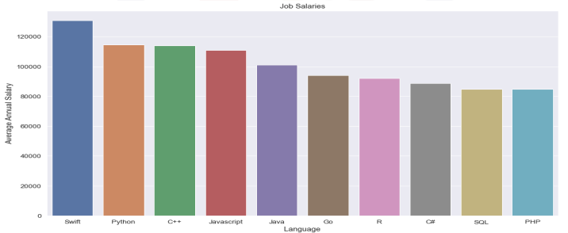
POPULAR LANGUAGES

